Slide 1

HireCentennial
Navigation Instructions
PART 1: JOBS
Job Postings
Job Alerts
CAREER SERVICES AND CO-OPERATIVE EDUCATION

Slide 2
JOB POSTINGS
CAREER SERVICES AND CO-OPERATIVE EDUCATION
Notes:
Start session with a poll to gather data on students vs. grads
“What is your current role at Centennial College?”
Current student
Graduate / alumni

Slide 3
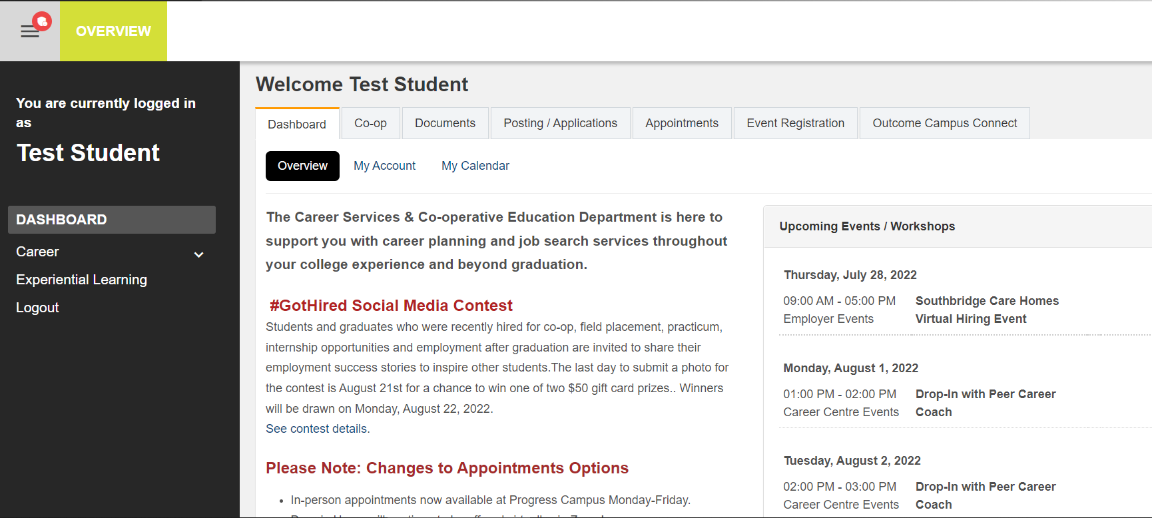
STEP 1 - How To Look For Jobs?
CAREER SERVICES AND CO-OPERATIVE EDUCATION
Notes:
Start session with a poll to gather data on students vs. grads
“What is your current role at Centennial College?”
Current student
Graduate / alumni

Slide 4
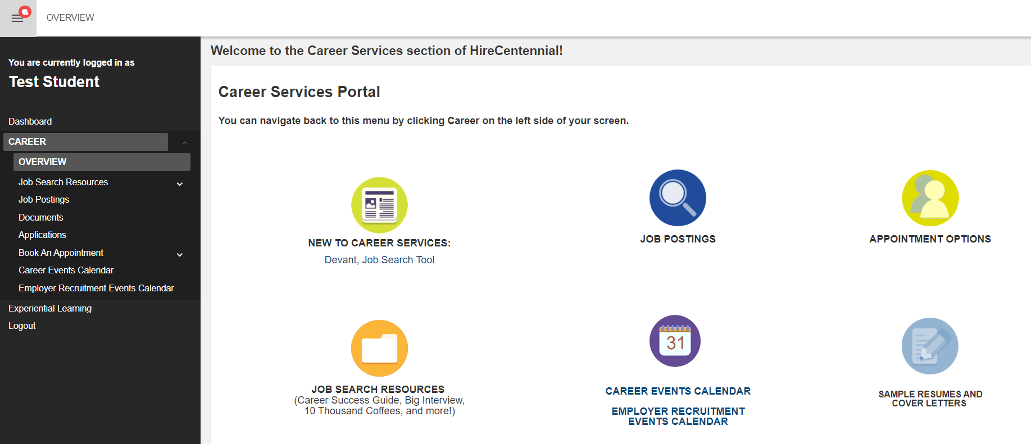
STEP 2 - How To Look For Jobs?
CAREER SERVICES AND CO-OPERATIVE EDUCATION
Notes:
Start session with a poll to gather data on students vs. grads
“What is your current role at Centennial College?”
Current student
Graduate / alumni

Slide 5
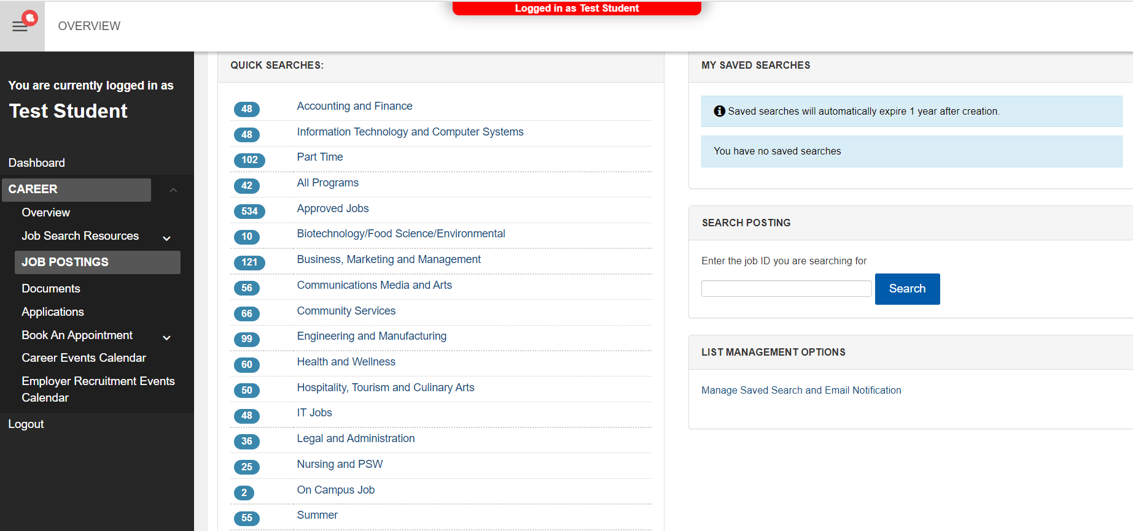
STEP 3 - How To Look For Jobs?
Choose program-specific, part time, volunteer, on campus, or summer jobs.
CAREER SERVICES AND CO-OPERATIVE EDUCATION
Notes:
Start session with a poll to gather data on students vs. grads
“What is your current role at Centennial College?”
Current student
Graduate / alumni

Slide 6
JOB ALERTS
CAREER SERVICES AND CO-OPERATIVE EDUCATION
Notes:
Start session with a poll to gather data on students vs. grads
“What is your current role at Centennial College?”
Current student
Graduate / alumni

Slide 7
STEP 1 - How To Set Alerts For New Jobs?
CAREER SERVICES AND CO-OPERATIVE EDUCATION
Notes:
Start session with a poll to gather data on students vs. grads
“What is your current role at Centennial College?”
Current student
Graduate / alumni

Slide 8
STEP 2 - How To Set Alerts For New Jobs?
CAREER SERVICES AND CO-OPERATIVE EDUCATION
Notes:
Start session with a poll to gather data on students vs. grads
“What is your current role at Centennial College?”
Current student
Graduate / alumni

Slide 9
STEP 3 - How To Set Alerts For New Jobs?
Select your program/ Type of job
CAREER SERVICES AND CO-OPERATIVE EDUCATION
Notes:
Start session with a poll to gather data on students vs. grads
“What is your current role at Centennial College?”
Current student
Graduate / alumni

Slide 10
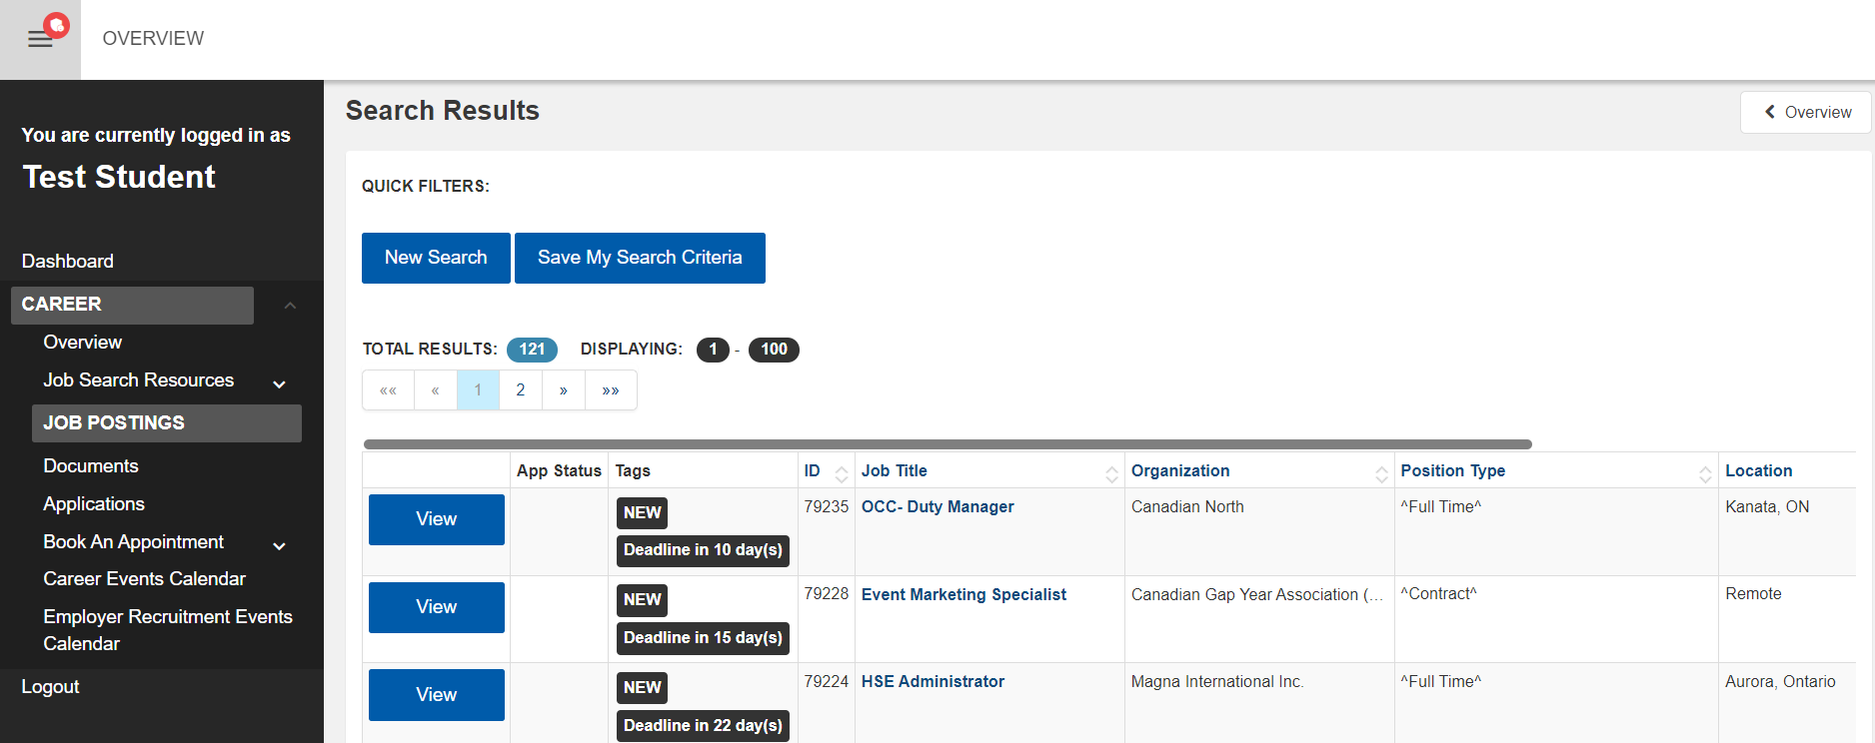
STEP 4 - How To Set Alerts For New Jobs?
CAREER SERVICES AND CO-OPERATIVE EDUCATION
Notes:
Start session with a poll to gather data on students vs. grads
“What is your current role at Centennial College?”
Current student
Graduate / alumni

Slide 11
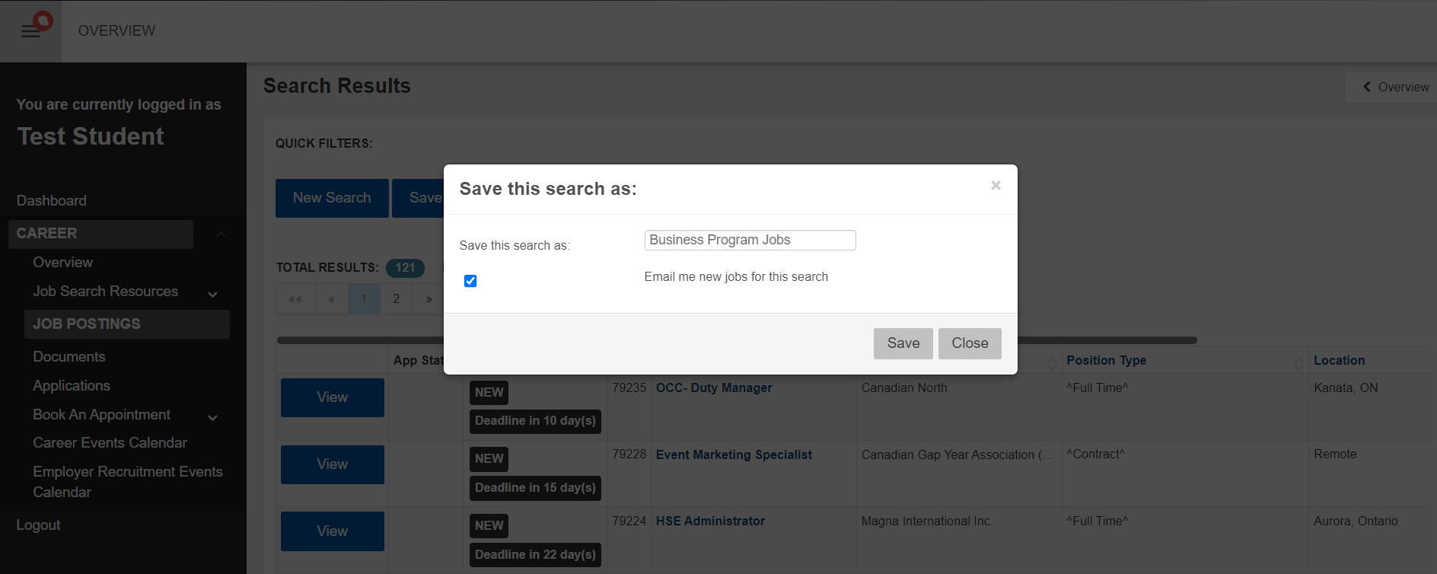
STEP 5 - How To Set Alerts For New Jobs?
Fill the text box
Check the “Email me new jobs for this search” box
Save
CAREER SERVICES AND CO-OPERATIVE EDUCATION
Notes:
Start session with a poll to gather data on students vs. grads
“What is your current role at Centennial College?”
Current student
Graduate / alumni

